Slide 1
Dynamic Traffic Light Control
Guide :Prof. P. M. Bagul.
Domain : Embedded Systems, IoT
Rohit Tondare
Rahulnarayan Iyer
Aditya Undre
Akanksha Patil

Slide 2
Abstract
In recent era, due to the increase in population and the number of vehicles bought, there is a problem of congestion of traffic in the major cities around the globe. This not only increases the time delay but also increases the fuel consumption and air and noise pollution. It is observed that conventional traffic flow is intricate and non predictable. Furthermore emergency vehicles like ambulances, fire trucks etc. are delayed. This project aims to solve the aforementioned problems by implementing real time control of the traffic signals using Image Processing, IoT and Object Detection. Embedded Systems are small and can be integrated with the existing infrastructure in order to reduce the cost and complexity.

Slide 3
Introduction
Unfortunately, in recent times the increasing number of vehicles can cause a series of economical as well and social problems.
However due to limited availability of land, the roads cannot be widened to suit the traffic needs.
Conventional traffic light systems use a fixed cycle of pre-defined pattern to control the dynamically changing traffic flow.
Dynamic Traffic Light Control refers to the control of flow of traffic via the signals in real-time.

Slide 4
Problem Statement
The purpose of this project is to develop a system that will solve the issue of excess traffic on a particular signal as well as have total synchronization between all the signals in a particular area. Additionally there is a problem for the emergency vehicles of not being able to pass through the signal without the presence of a traffic cop.

Slide 5
Survey
In our personal interview with the DCP of Traffic, Mr. Pankaj Deshmukh, mentioned that currently there is a huge lack in infrastructure in our city.
The road and signal infrastructure is not able to cope up with the rapid growth in number of cars.
Wrote a paper on the different types of systems currently implemented.
Different Systems like Fuzzy Logic, Image Processing, Wireless Sensor Network, Dynamic Programming and IR sensor with IoT were studied.

Slide 6
Motivation
It commonly occurs that, at a particular intersection there is high density of traffic in one lane and there is very low density of traffic in the others. Despite that, the green time for all the lanes are the same.
Another major problem is the excess waiting time for emergency vehicles. Due to the Static nature of current system, there is no easy way to detect emergency vehicles.

Slide 7
Proposed Work
In order to reduce the waiting time at a signal, we are proposing the use of Dynamic Traffic Light control with the help of Image Processing, IoT and Object Detection.
The major data will be collected from the existing CCTV cameras.
With the help of the data from the CCTV cameras, Emergency vehicles also will be detected.
With the help of this system, there will be no waiting time for Emergency vehicles.
There will be intercommunication between signals at adjacent intersections as well as between the signals at an intersection in order to have a full interconnection and synchronization in the system.

Slide 8
Methodology
We will be calculating the traffic density with the help of the current CCTV footage which will be supported by google maps traffic data.
The communication between two signals will be done with the help of ESP8266 Node MCU.
We will then obtain the traffic density in each lane.
Whichever lane will have highest traffic density will be given priority over other lanes and its signal will be made green.
At the same time the traffic signals at an intersection will be interacting/communicating with each other so as to know the amount of traffic coming its way.
Based on all this data which signal has to be made green next is decided.

Slide 9
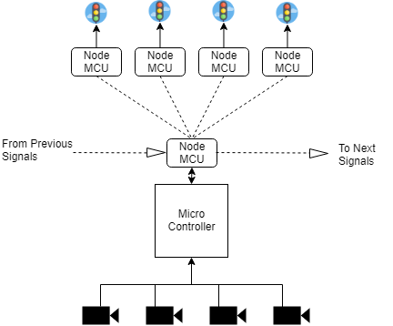
Block Diagram

Slide 10
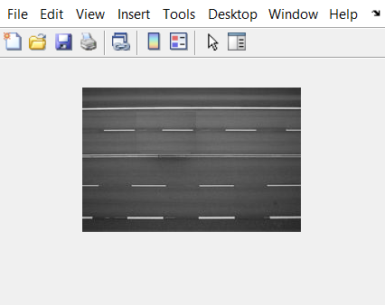


Mini Project - Concept

Slide 11
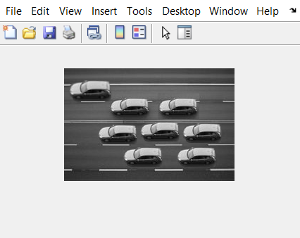
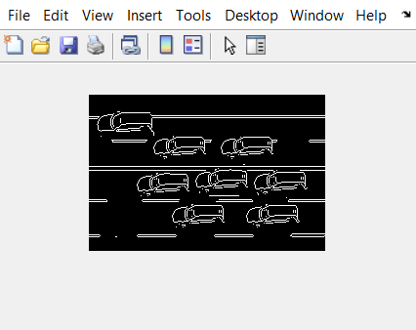
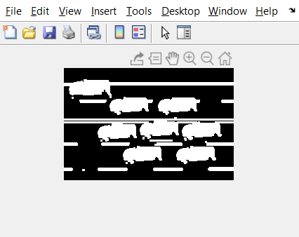
Image Processing for Static Data

Slide 12
Expected Outcome
By implementing this system we expect the following:
Reduction in congestion of vehicles.
Less delay in reaching a destination.
More priority to emergency vehicles.
Reduction in Pollution.

Slide 13
References
Dynamic Traffic Light Control Systems - A Survey.
Paper Comparing the Different types of Currently implemented Solutions for Dynamic Traffic Light Control.

Slide 14
THANK YOU

